Slide 1

S2 Progress Report
Optimal control of Trajectory of reusable launcher in OpenMDAO/dymos
Students:
Alberto Fossà
Giuliana Elena Miceli
Tutors:
Laurent Beauregard
Joseph Morlier
Stéphanie Lizy-Destrez
2 April 2019

Slide 2
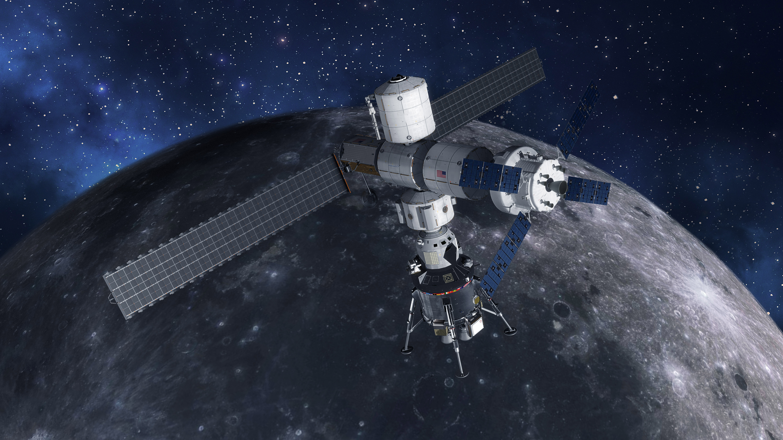
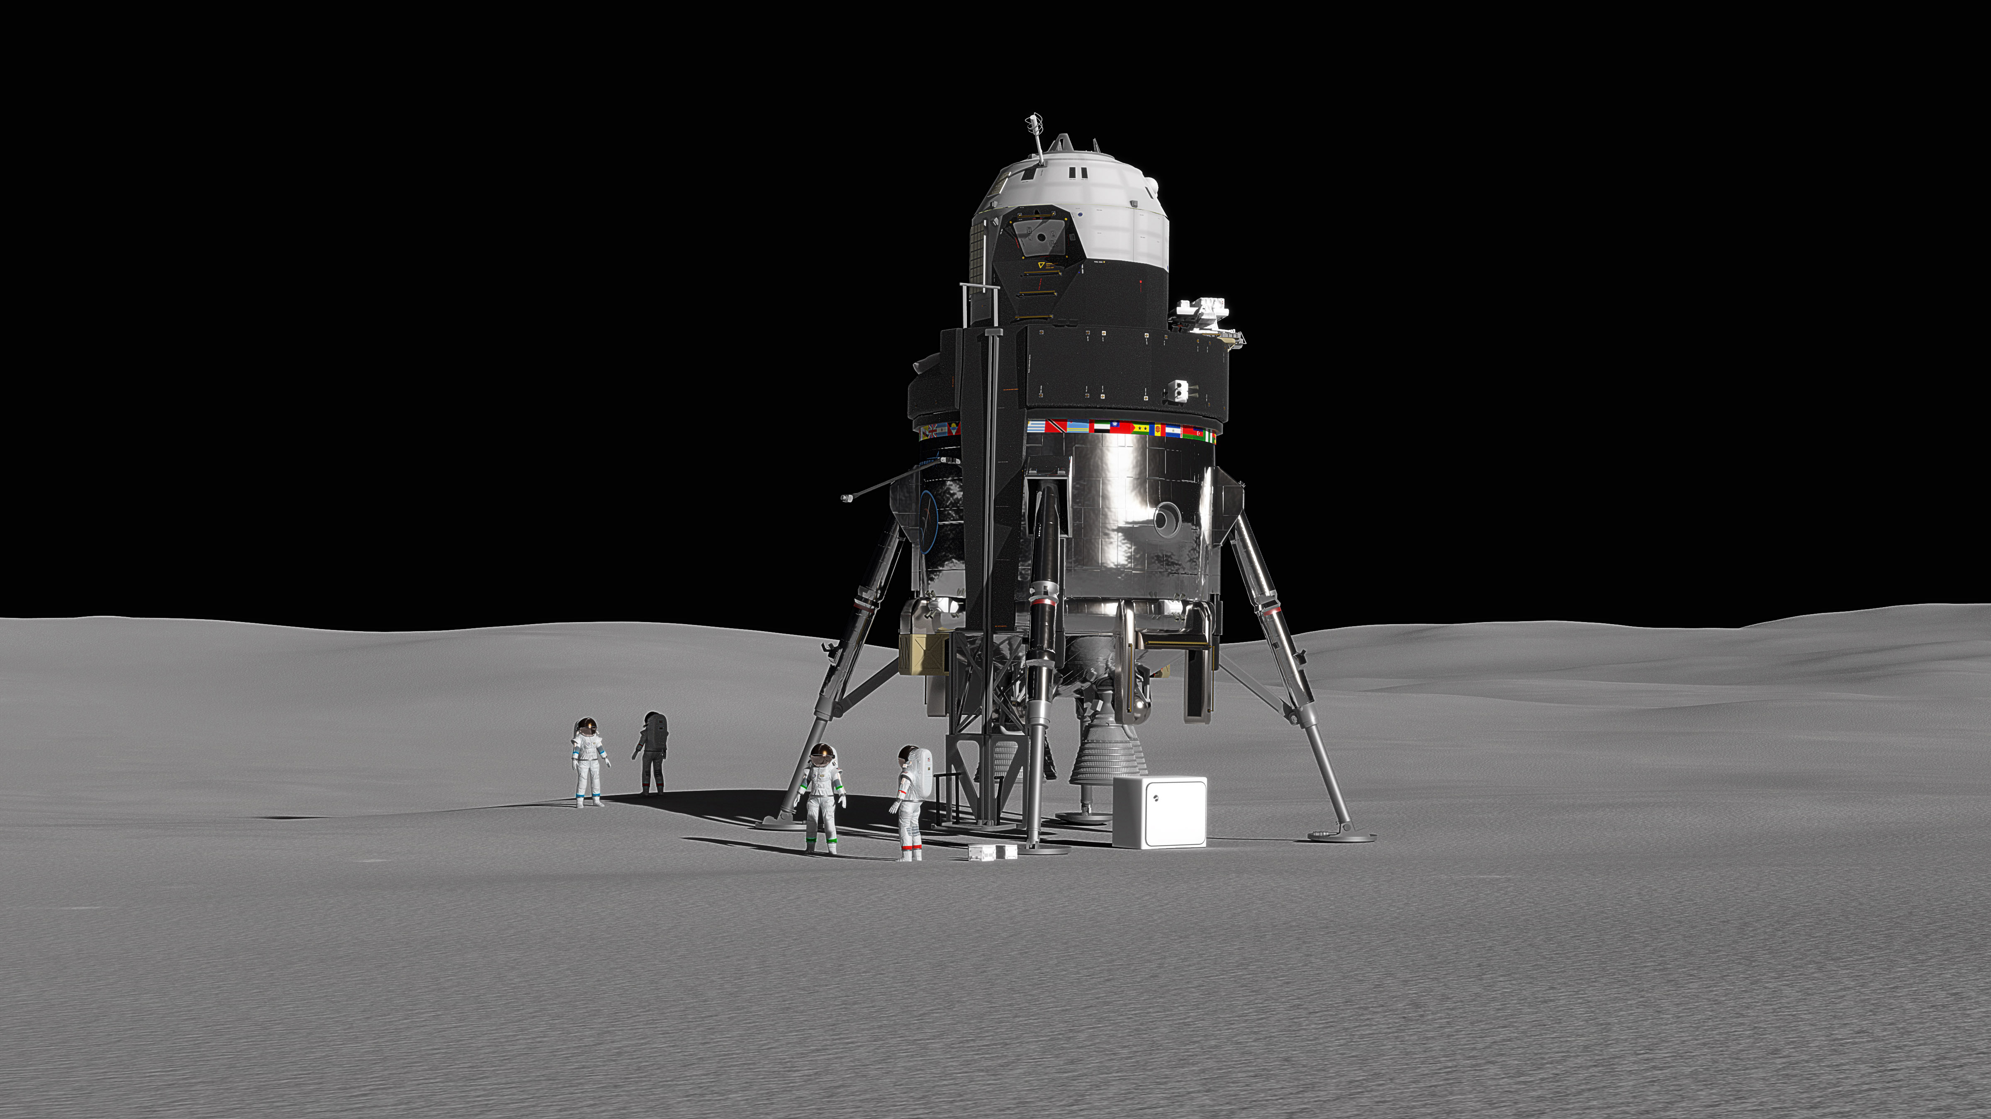
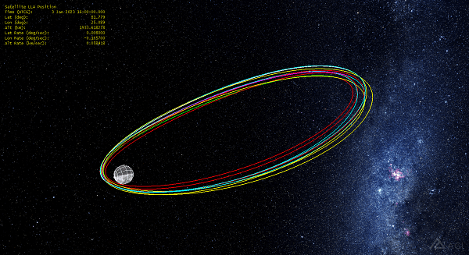
Context
Lunar Orbit Platform-Gateway
Reusable Lander
Near Rectilinear Halo Orbit

Slide 3
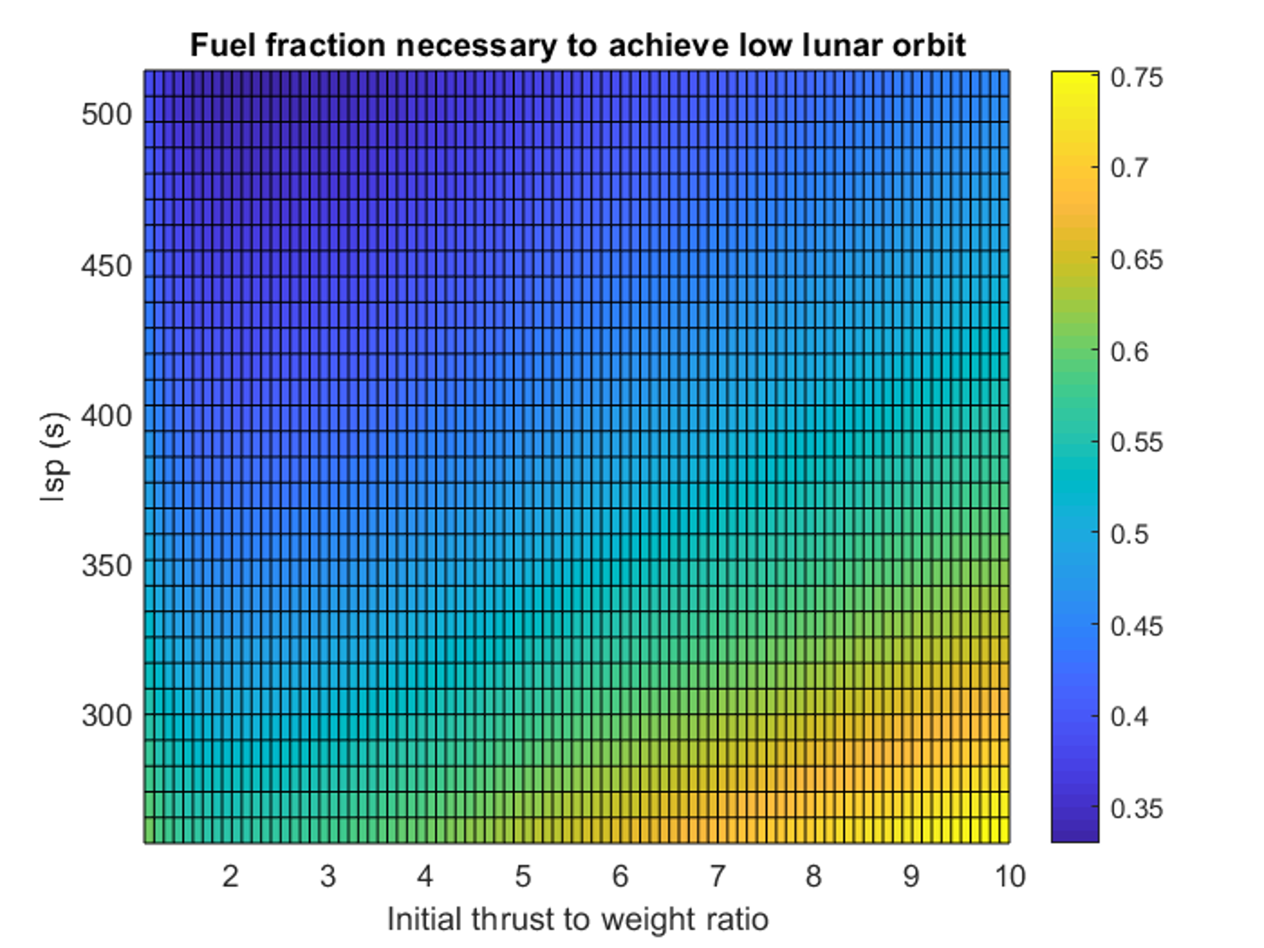
State of the Art
Ascent
Descent
Thrust direction and altitude profile
Propellant fraction for varying ISP and thrust
Throttle value and altitude vs time

Slide 4
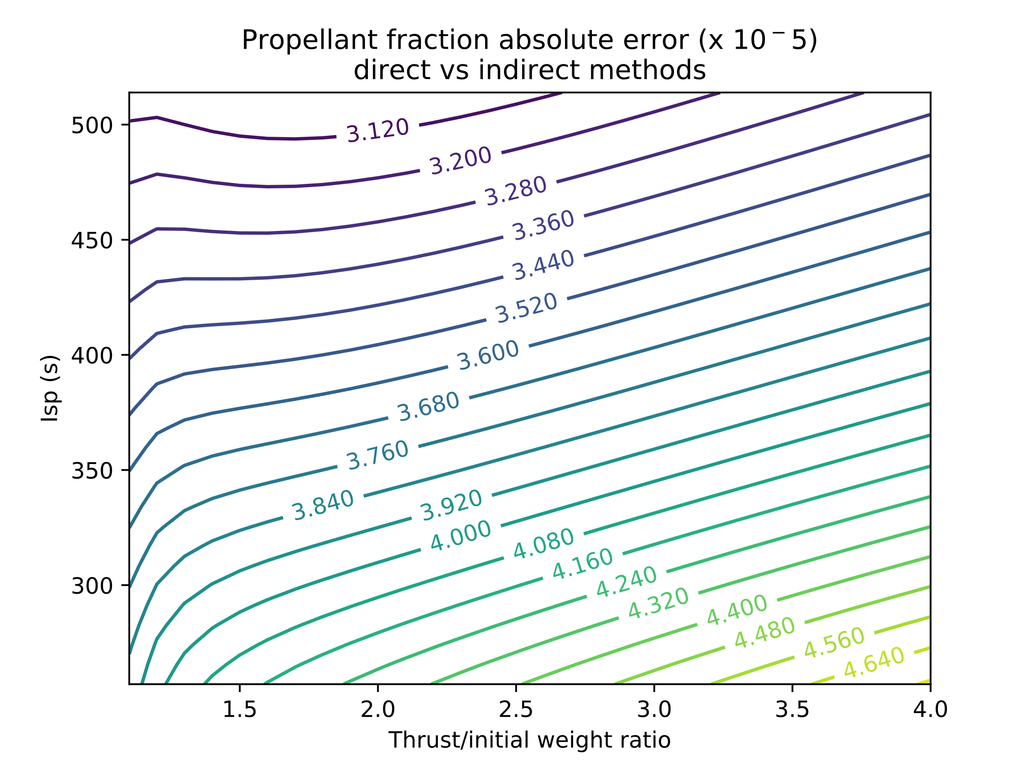
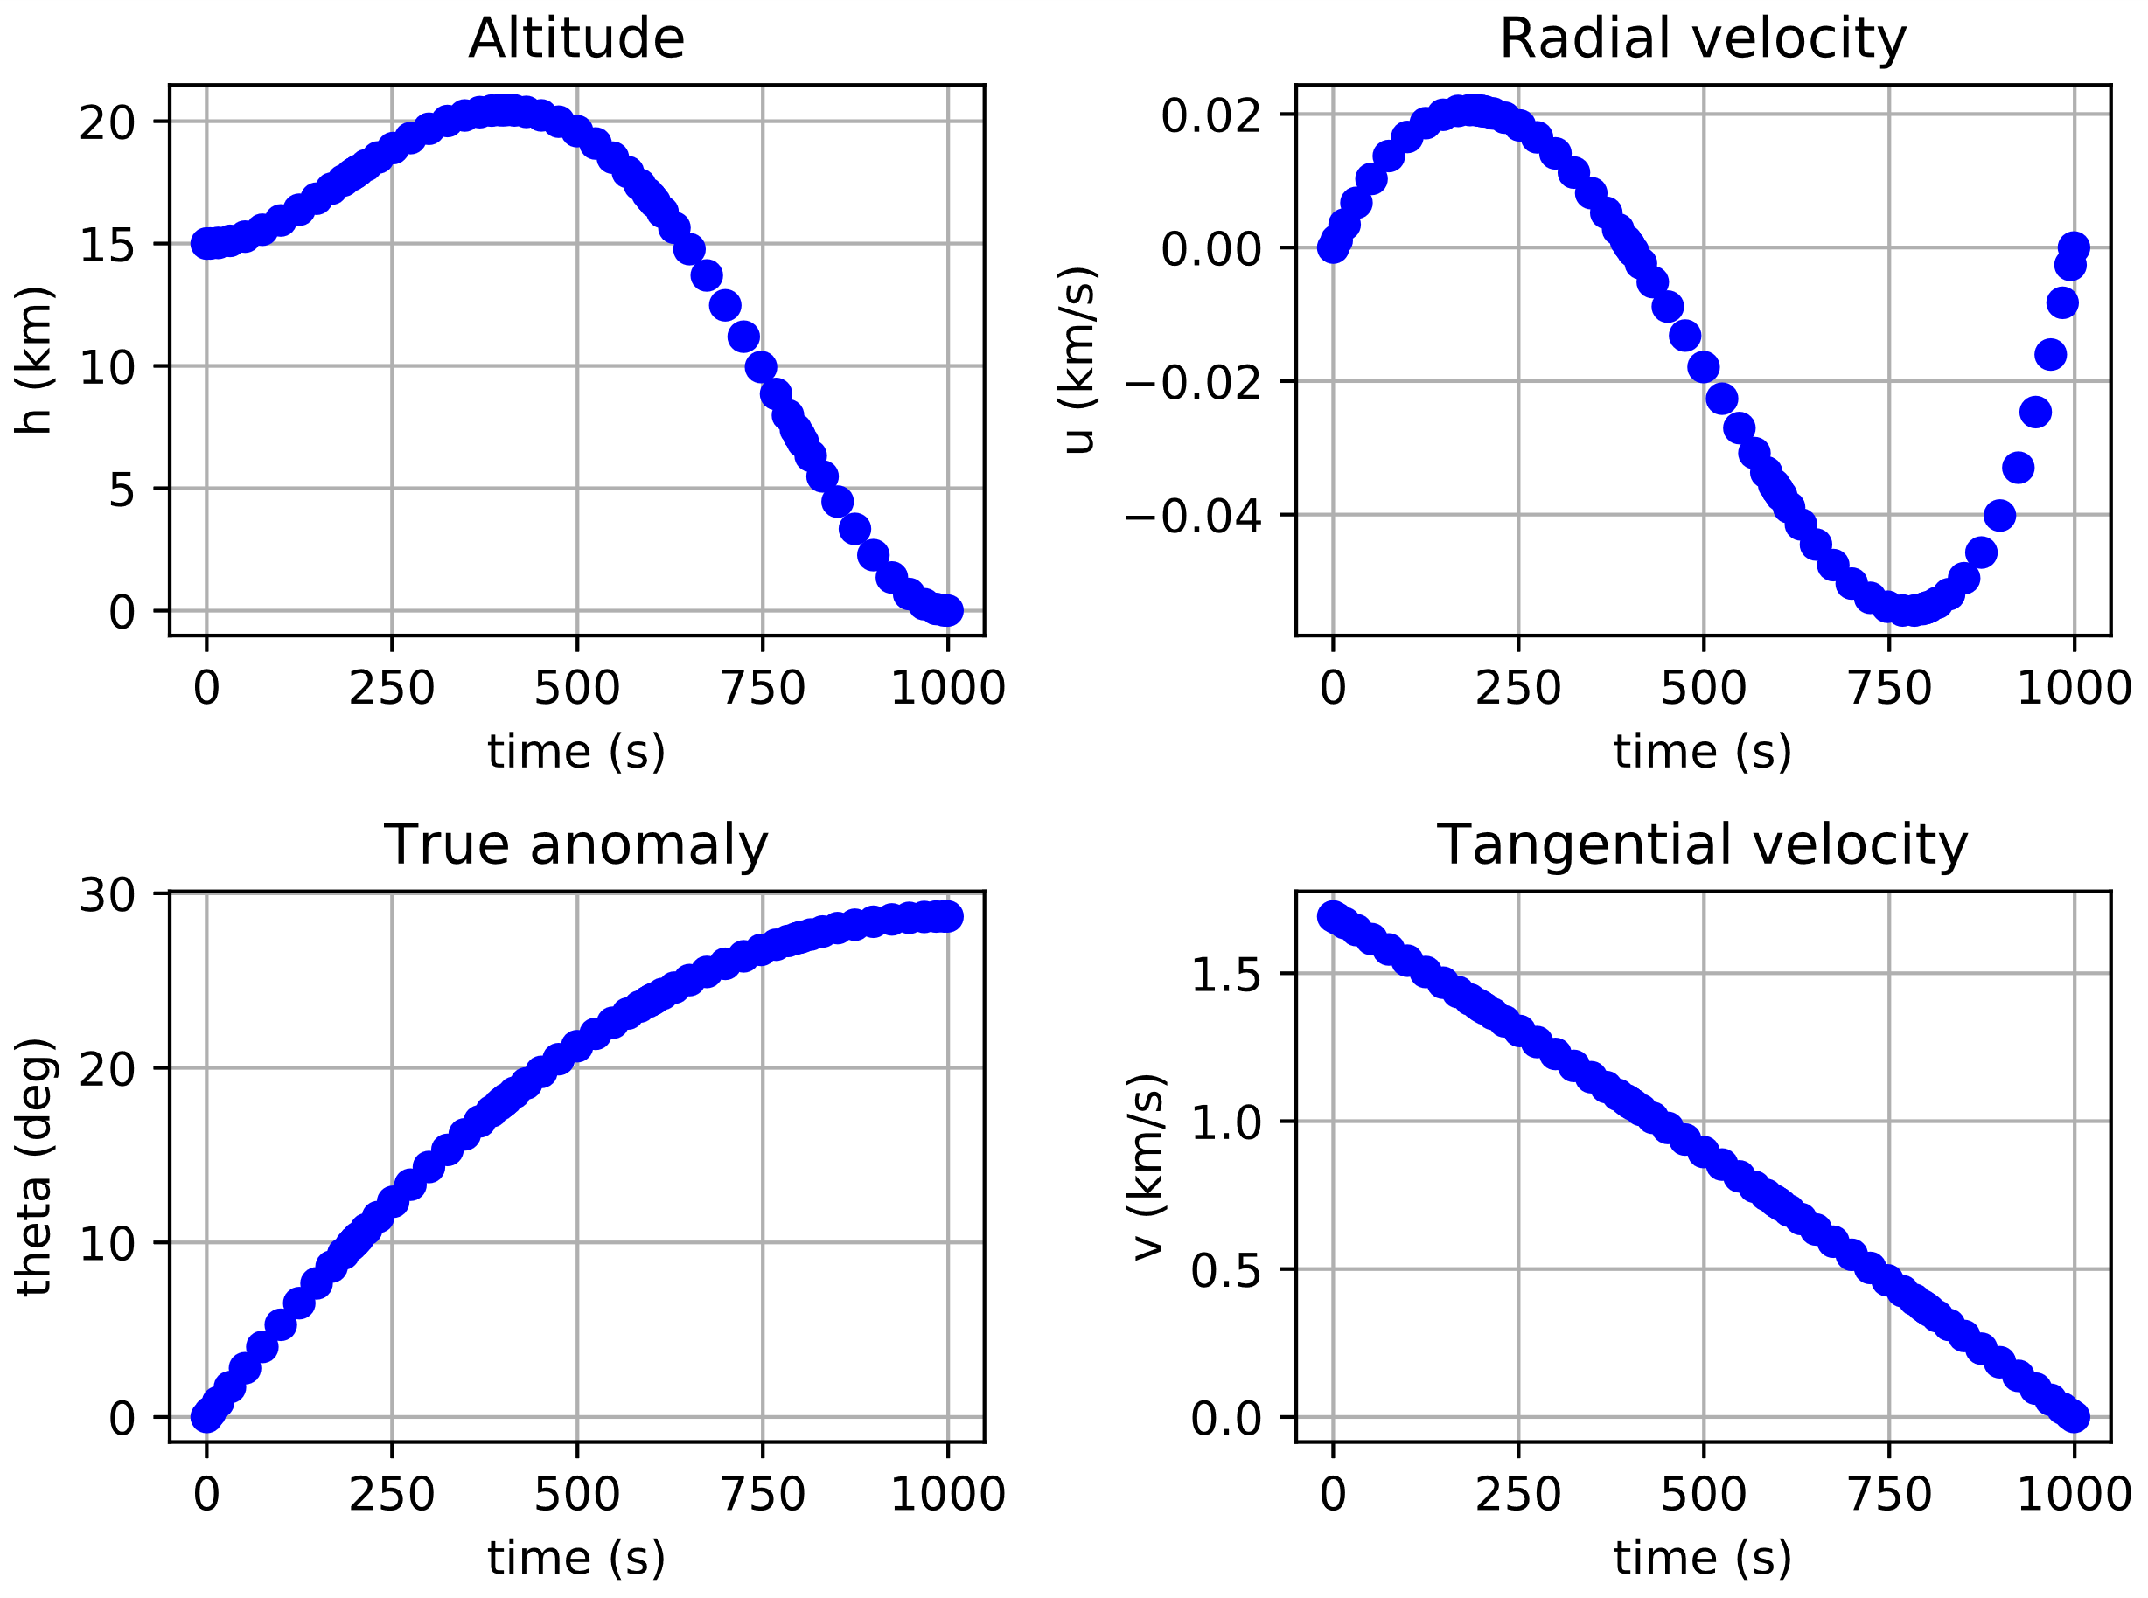
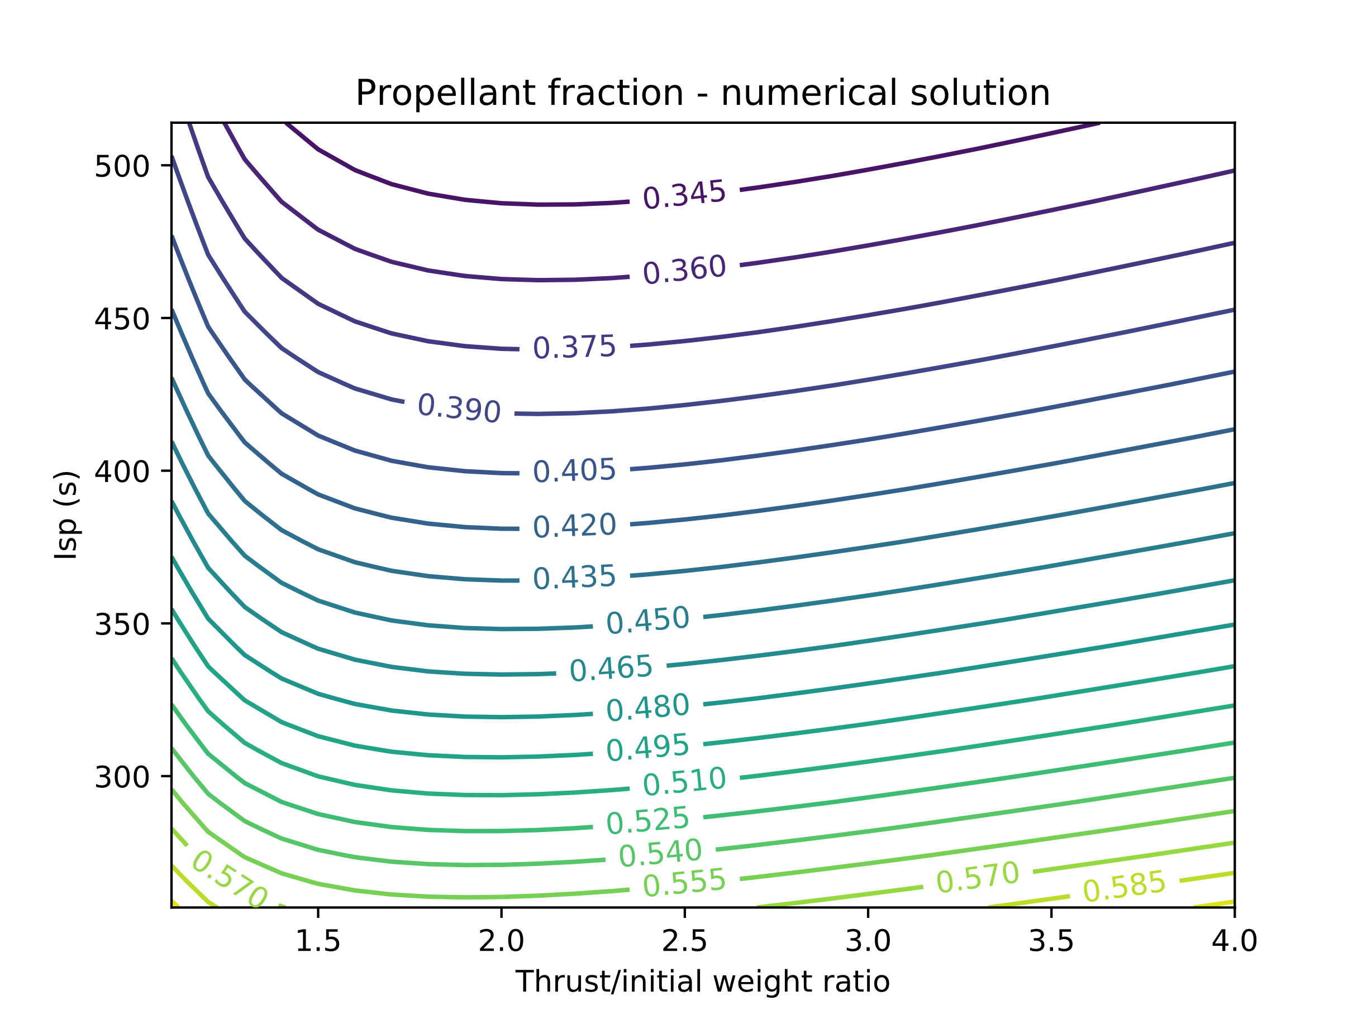
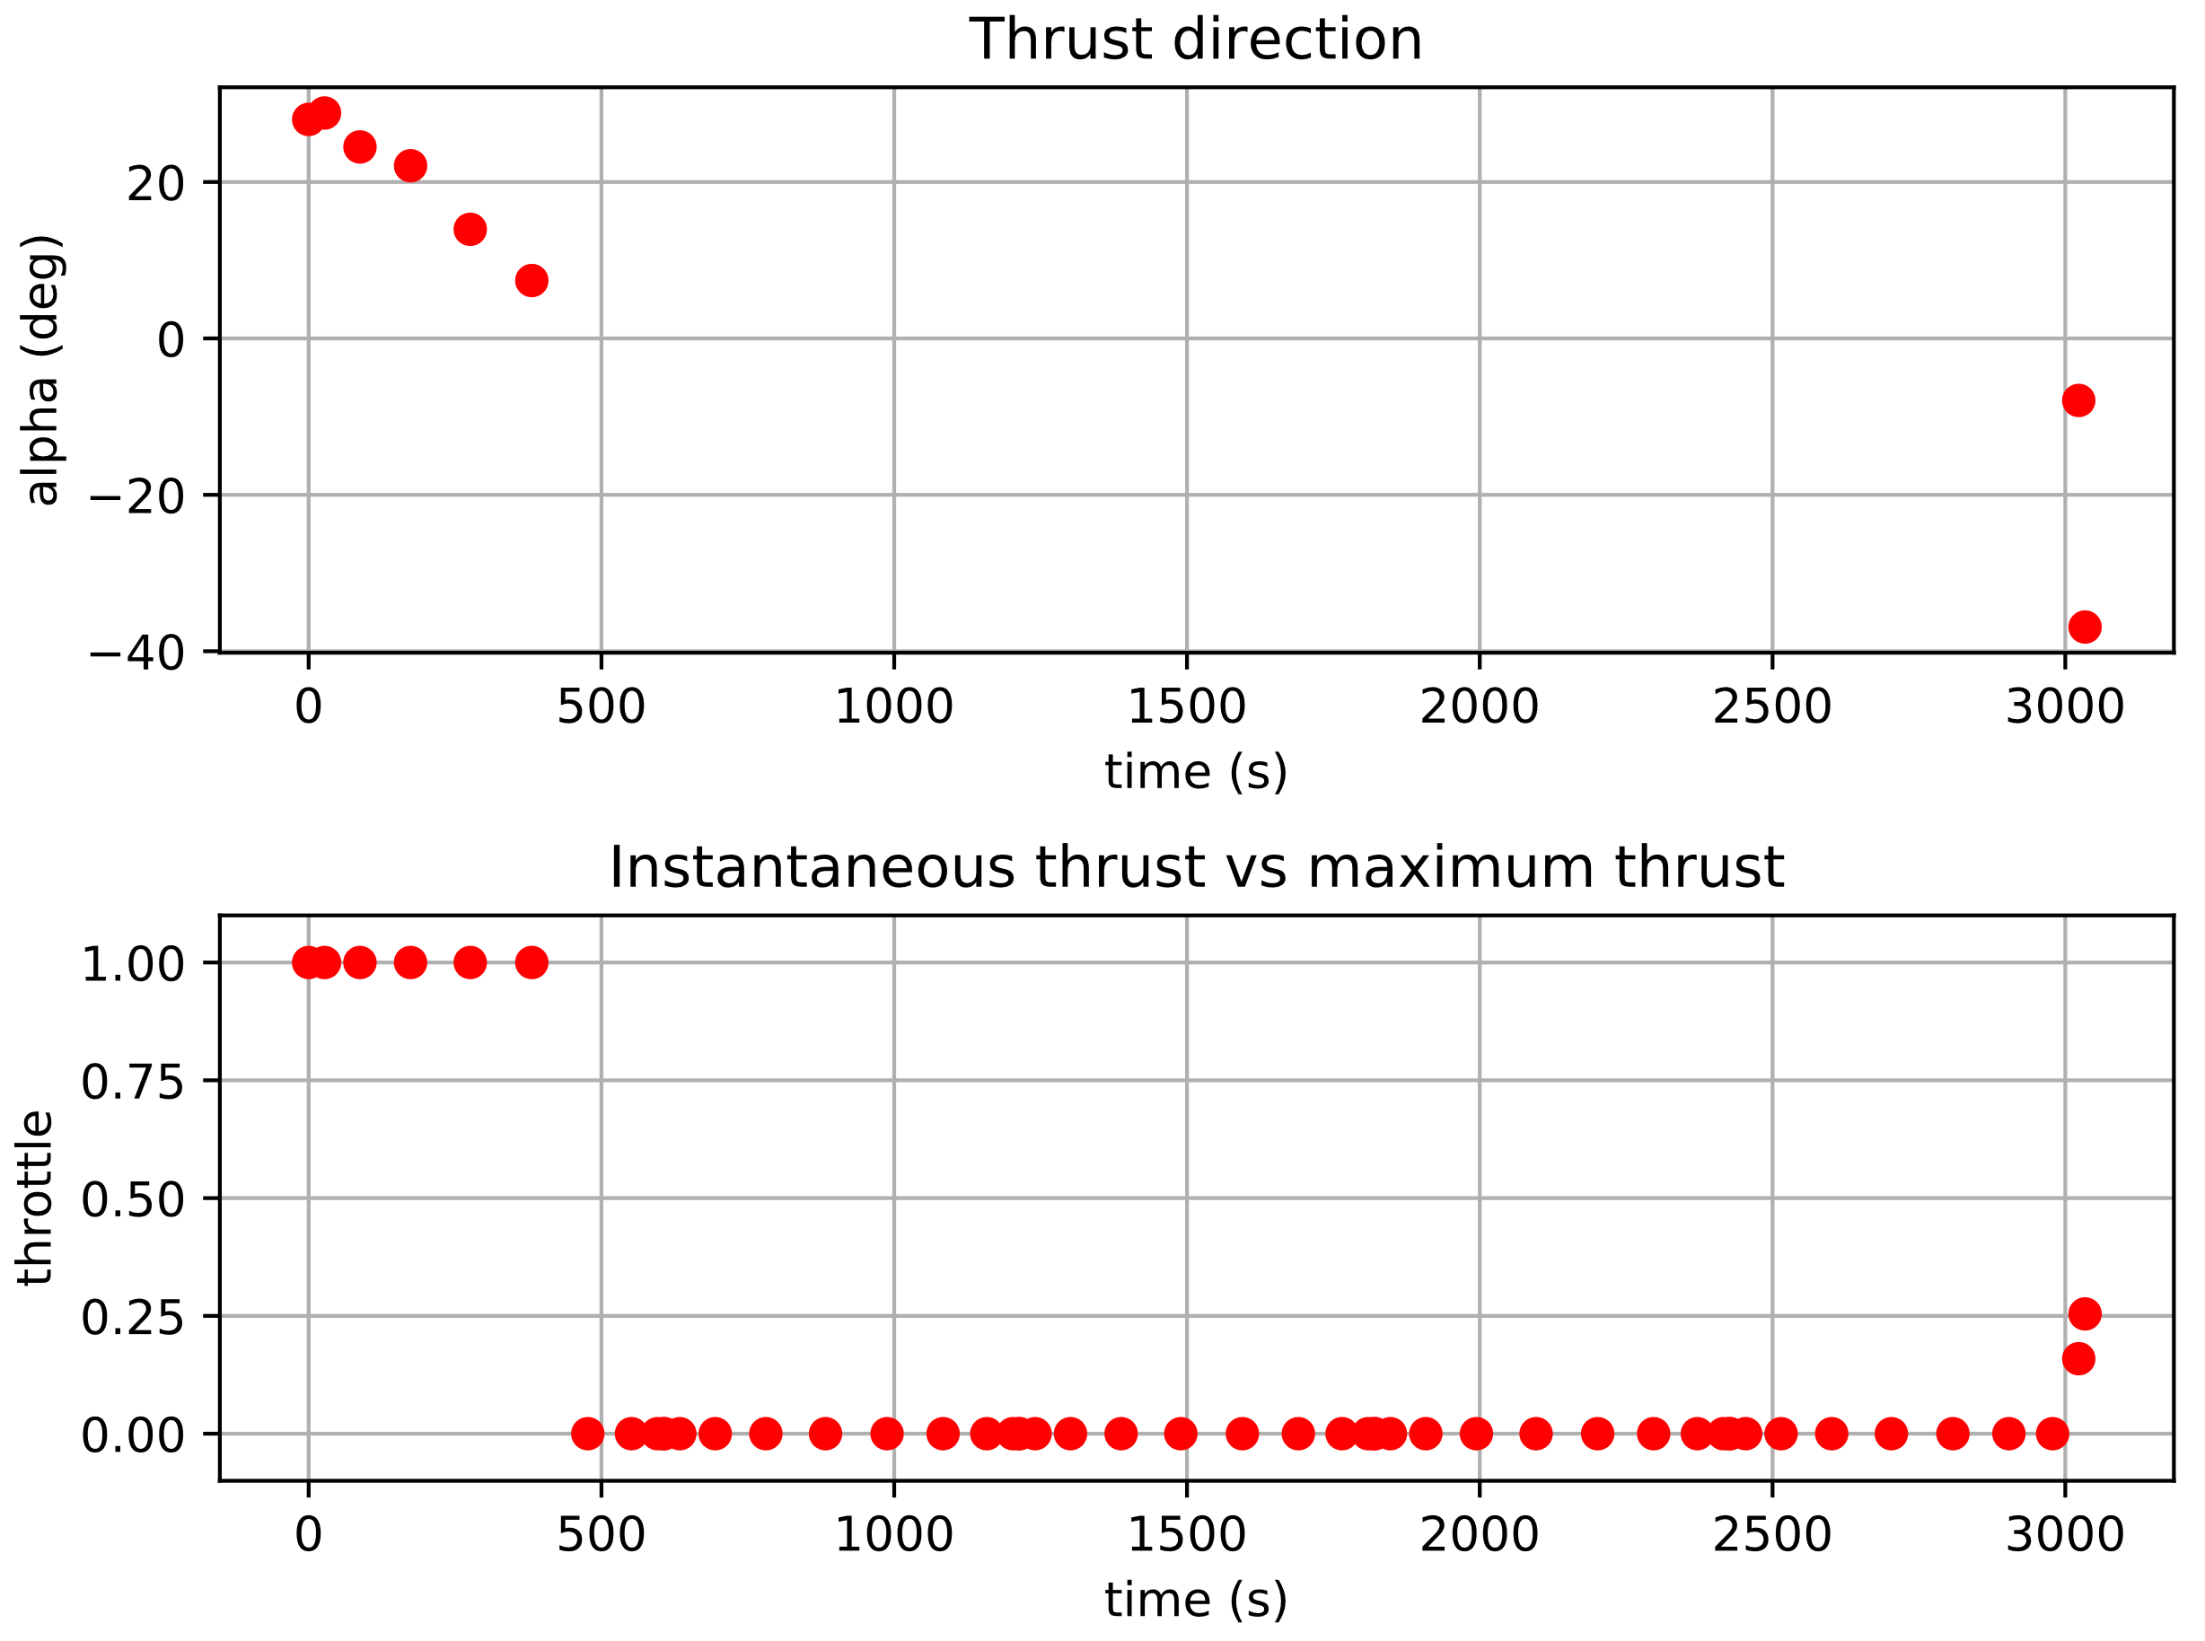
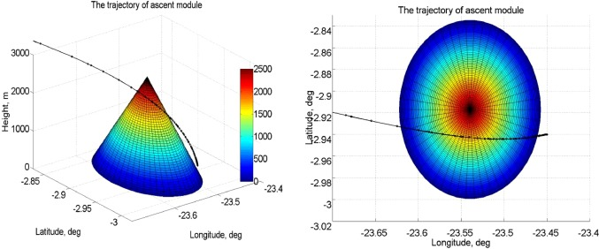
Planning
Achieved goals:
Future tasks:
Vertical-rise phase/vertical final path during descent
Geographical constraints due to lunar highlands
Rocket attitude and inertia model
3D trajectories
Launcher control law

Slide 5
Thank you for your attention!
Questions?

